Slide 1
We will be creating a social media Application:
We will plan following urls for our project.
Let’s suppose a user can have multiple posts in a website
GET /users : Retrieve all users
POST /user :Create a new user
GET /users/{id} :Retrieve a Particular user
DELETE /users/{id} : Delete a particular user
To retrieve all posts for a user:
GET /users/{id}/posts
To create a new post for a user
POST /users/{id}/posts
To retrieve details of a post
GET / users/{id}/posts/{posts_id}

Slide 2
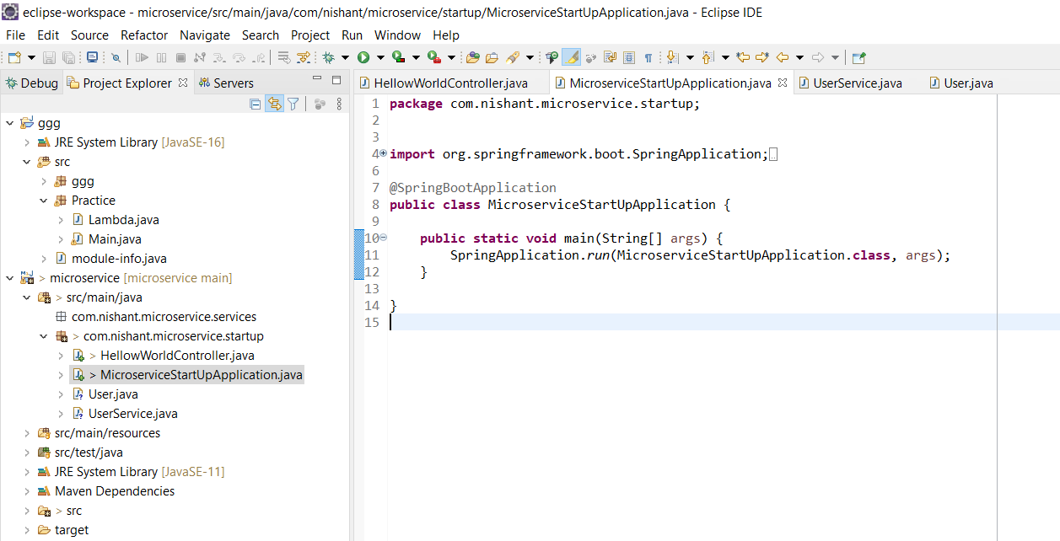
Start a spring boot project on localhost:8080

